Slide 1
Parallel Computing – Matlab – Part 1
Shelley Knuth
shelley.knuth@colorado.edu
www.rc.colorado.edu
Slides: https://github.com/ResearchComputing/Parallelization_Workshop

Slide 2
Outline
Profiling
Vectorization
Multi-threading
Parallel Matlab
Parallel Computing Toolbox
Prepping your GUI
Submitting jobs
Parfor

Slide 3
My code is sloooowwww
What is the problem I have with my serial code?
Is it too slow? Where is it too slow?
Can I vectorize my code to improve speedup?
Can I use a function that implicitly uses parallelism?
Can I use multi-threading?
Do I have a for loop I am trying to speed up?

Slide 4
Step One…
Where is my code slowing down?
Tic and Toc
Can’t tell you exactly what within that code is slowest
Let’s use the profiler
Simple_loop.m
Code analyzer is another good tool to use
Take five minutes and use the profiler on some code you have
Does it make sense to reduce any loop iterations?

Slide 5
Step Two…
Are there any places where my code could benefit from vectorization? Pre-allocation?
Pre-allocation: initialize arrays ahead of time to avoid dynamic resizing
And if not, can I implement some type of parallelization?
Making use of existing functions
Multi-threading
The Parallel Computing Toolbox

Slide 6
Vectorization
https://www.mathworks.com/help/matlab/matlab_prog/vectorization.html
Process of revising loop-based, scalar-oriented code to use MATLAB matrix and vector operations
Do this because:
Appearance: looks like textbook math, so easier to understand
Less opportunity for error
Usually runs much faster than code that
contains loops
Great option in Matlab because its
optimized for operations involving matrices
and vectors

Slide 7
Example of Vectorization
The code below demonstrates how a loop could be vectorized in Matlab
% Non-vectorized
a= rand(1,4);
b= rand(1,4);
for k= 1:length(a)
c(k)= a(k) + b(k);
end
% Vectorized
a= rand(1,4);
b= rand(1,4);
c= a + b;
Notes:
Two sets of code give the same result, but the code is behaving differently to get that same answer. The vectorized optimized functions under the hood
Data parallelization – working on multiple data at the same time

Slide 8
Existing Functions
Certain functions in Matlab utilize the programming constructs of parallel computing implicitly to run the functions in parallel on a multi-core system
These functions are automatically multi-threaded
Little work, but potentially lots of gain
No control over the processing
Examples:
Fft, fmincon, ode, and many others

Slide 9
Threads
A thread is a sequence of instructions within a program that can be executed independently of other code
It is a component of a process
Every line in a program is a thread
This is called your main thread, or your serial thread

Slide 10
Multi-threading
Multi-threading occurs when you reach a point in your program where these instructions can be executed not only independently but also simultaneously
On multiple cores
Multi-threading is a form of parallelism, but lighter than distributed computing
Programming constructs such as OpenMP use multi-threading as their basis
One of the biggest differences between multi-threading and distributed computing or larger-scale parallelism is that multi-threading uses shared, rather than distributed, memory

Slide 11
Multi-threading Real World Example
Say you have a project: building a subdivision
There are ten houses that will be built in this subdivision
There are several components of the project that need to be completed on each of the houses
Pouring the foundation
Framing the house
Putting in the kitchen
Laying the carpeting
Landscaping
Etc, etc

Slide 12
Multi-threading Real World Example – Cont.
Each component requires individual tasks to complete it
For example, when landscaping one must pour the driveway, lay the grass, select shrubs, etc to plant, put in lighting, etc.
There is a general contractor in charge of the entire project
The general contractor has ten workers

Slide 13
Multi-threading Real World Example - Continued
The general contractor divides up the tasks in the subdivision based on skill set or time
The five workers work on each of the tasks
The general contractor is the client
The workers are the cores
The tasks for each individual project are the threads
When the tasks are worked on at the same time by the workers it is multi-threading

Slide 14
Multi-threading Programming Example
Say you have a program that does a matrix multiplication of two 2x2 square matrices
Each part of the calculation, where a row element is multiplied by a column element, can be thought of as a thread
You can implement multi-threading implicitly or explicitly
In Matlab, implicit occurs by using certain functions
Explicitly might mean implementing multi-threaded flags in slurm or using the PCT

Slide 15
Multi-threading example
multi_threading.sh
multi_threading.m
Show speed up on 1 vs. 24 cores
But first….

Slide 16
Before we go further…
Let’s look at running Matlab on the supercomputer
The best way to do this is to call your Matlab program from a bash script
Within the bash script will be several flags that help specify your job requirements

Slide 17
Sample (Partial) Bash Script
#!/bin/bash
#SBATCH --nodes=1
#SBATCH --ntasks=24
matlab -nosplash -nodesktop -r "clear; num_workers=$SLURM_NTASKS; parallel_std;”
RC’s Matlab license does not allow for parallel computation across nodes
Module load slurm/summit

Slide 18
Notes on Running Matlab on a Cluster
Request the number of cores on the cluster and also the number of workers that will perform operations on those cores
In older versions of Matlab you had to
manually open a pool of workers
Now it does in when run PCT command

Slide 19
Matlab vs Slurm – who wins?
You can open a parallel pool of workers in Matlab
You also request a specific number of cores
If the two are the same then no issue
What if you ask for more cores than workers?
Each worker will operate on a core and the other cores will be idle
What if you ask for less cores than workers?
The code will fail
Will say that the default value for a local cluster is the number of cores available
Notes:
Can’t oversubscribe in Matlab

Slide 20
Multi-threading example
multi_threading.sh
multi_threading.m
Show speed up on 1 vs. 24 cores

Slide 21
Explicit parallelism
Several instances of Matlab run on several cores or computers
May have shared or distributed memory
Simultaneously execute a single Matlab command or function
In explicit parallelism, programmers can create and manage their parallelism to suit their needs
Can choose the processors to run on
Apple cores. One type of core.

Slide 22
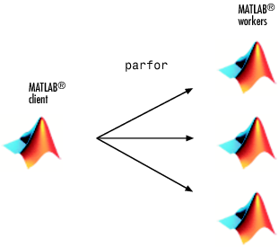
Parallel Matlab
When you start up a Matlab session by opening Matlab, you are starting a client session
Creates workers, receives results, distributes work
Move to a parallel session requires the client to pass some of its computational work along to Matlab workers
https://www.mathworks.com/help/distcomp/how-parallel-computing-products-run-a-job.html

Slide 23
Parallel Matlab
A Matlab worker is an individual Matlab session
Usually have one worker per core on your system
Same as client without front end – just computation
Workers can communicate with each other and to the client
Workers complete tasks to help speed up job completion
Must run independently
https://www.mathworks.com/help/distcomp/how-parallel-computing-products-run-a-job.html

Slide 24
Parallel Computing Toolbox (PCT)
Matlab offers explicit parallelism within the Parallel Computing Toolbox
Perform parallel computations on multicore computers, GPUs, and computer clusters
Mimics OpenMP in many ways
Many Matlab functions work in concert with the PCT
Simple to utilize with just the use of certain commands

Slide 25
Requirements to Run PCT
Access to Matlab
The PCT add-on
Prohibitively expensive for individuals
Likely accessing through institution
At CU you have access to a Matlab site license
Where can I run PCT?
On cluster (Summit)
On your laptop
On your desktop/workstation

Slide 26
Parallel and the GUI
You can set parallel constructs either in your script or in the Matlab Desktop
In order to utilize the PCT, you must open up a pool of parallel workers
You can do this explicitly by running the command parpool
You can also set this explicitly in the GUI to do automatically

Slide 27
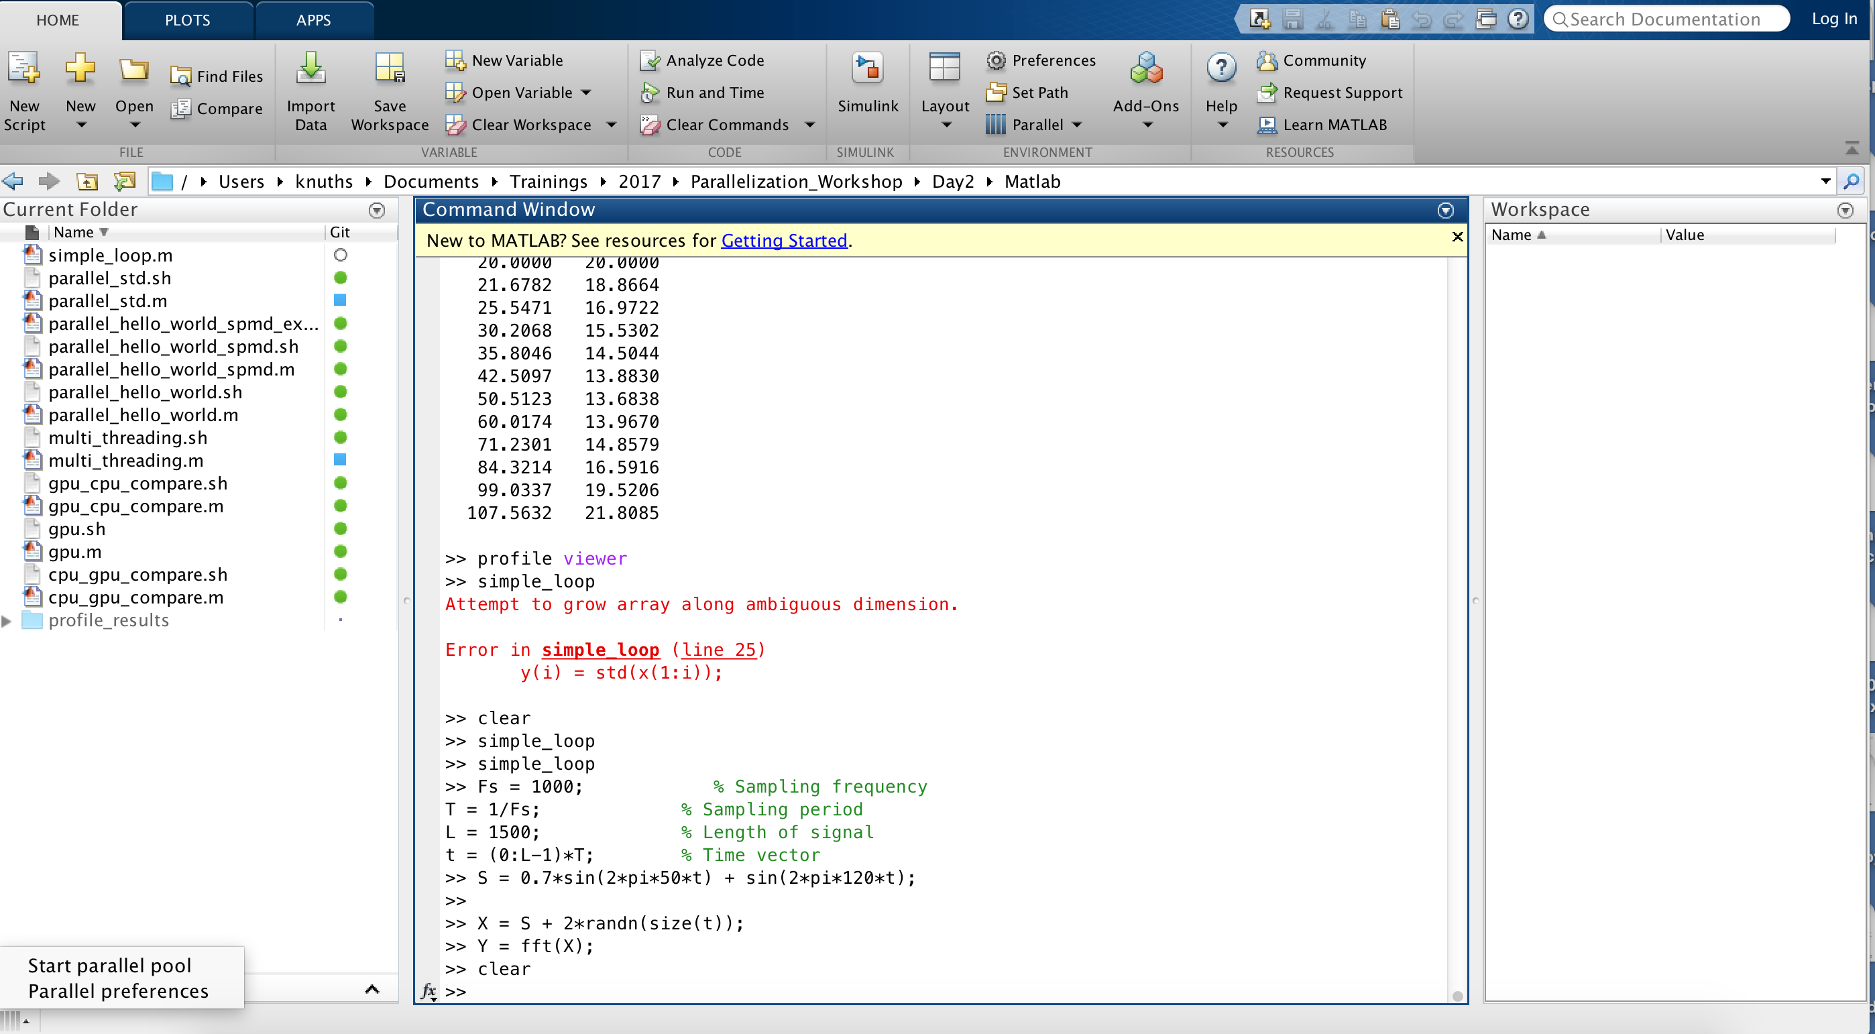
Starting a parallel pool from GUI

Slide 28
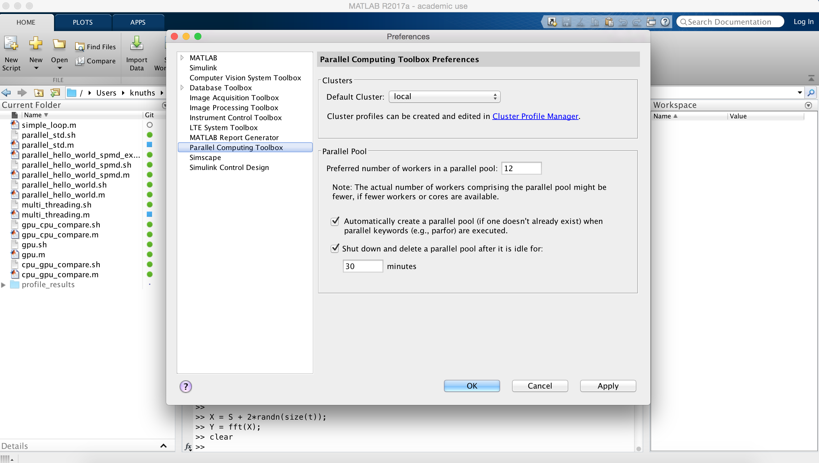
Parallel Preferences

Slide 29
parfor
Loops are slow – this is a good place to start
Matlab workers execute loop iterations in parallel on workers in parallel pool simultaneously
Matlab client issues the parfor command and coordinates with workers
Must have a parallel pool to use
Cannot nest parfor loops

Slide 30
Parallel and Not Parallel
Not Parallel:
for i=1:10
x=x(i)+1;
end
Parallel:
parfor i=1:10
x=x(i)+1;
end

Slide 31
When to Use Parfor
If you have determined your for loop is causing a bottleneck
If your loop iterations are completely independent
Many iterations of the same calculation
If you are not making any global variable declarations
Your loop does not contain any break or return statements
If you have the PCT

Slide 32
Running Matlab in Parallel
Let’s take a serial for loop and convert it to run in parallel
parallel_std.sh
parallel_std.m
Notes:
A broadcast variable is any variable, other than the loop variable or a sliced variable, that does not change inside the loop. At the start of a parfor-loop, the values of any broadcast variables are sent to all workers. This type of variable can be useful or even essential for particular tasks. However, large broadcast variables can cause significant communication between client and workers and increase parallel overhead. Sometimes it is more efficient to use temporary variables for this purpose, creating and assigning them inside the loop.

Slide 33
Your Turn
Write up Matlab code that instructs each of the workers to print ”Hello World” each time the parfor loop runs
Use 24 workers
Set up your slurm configurations properly

Slide 34
Result
Parallel_hello_world.sh
Parallel_hello_world.m

Slide 35
Pmode
One last thing…
There’s a parallel profiler GUI
Let’s start it up!
sinteractive –-reservationname=parallelD2
Once Matlab starts, type pmode start
x=2*labindex
This will only work if you have X-windows installed on your local system

Slide 36
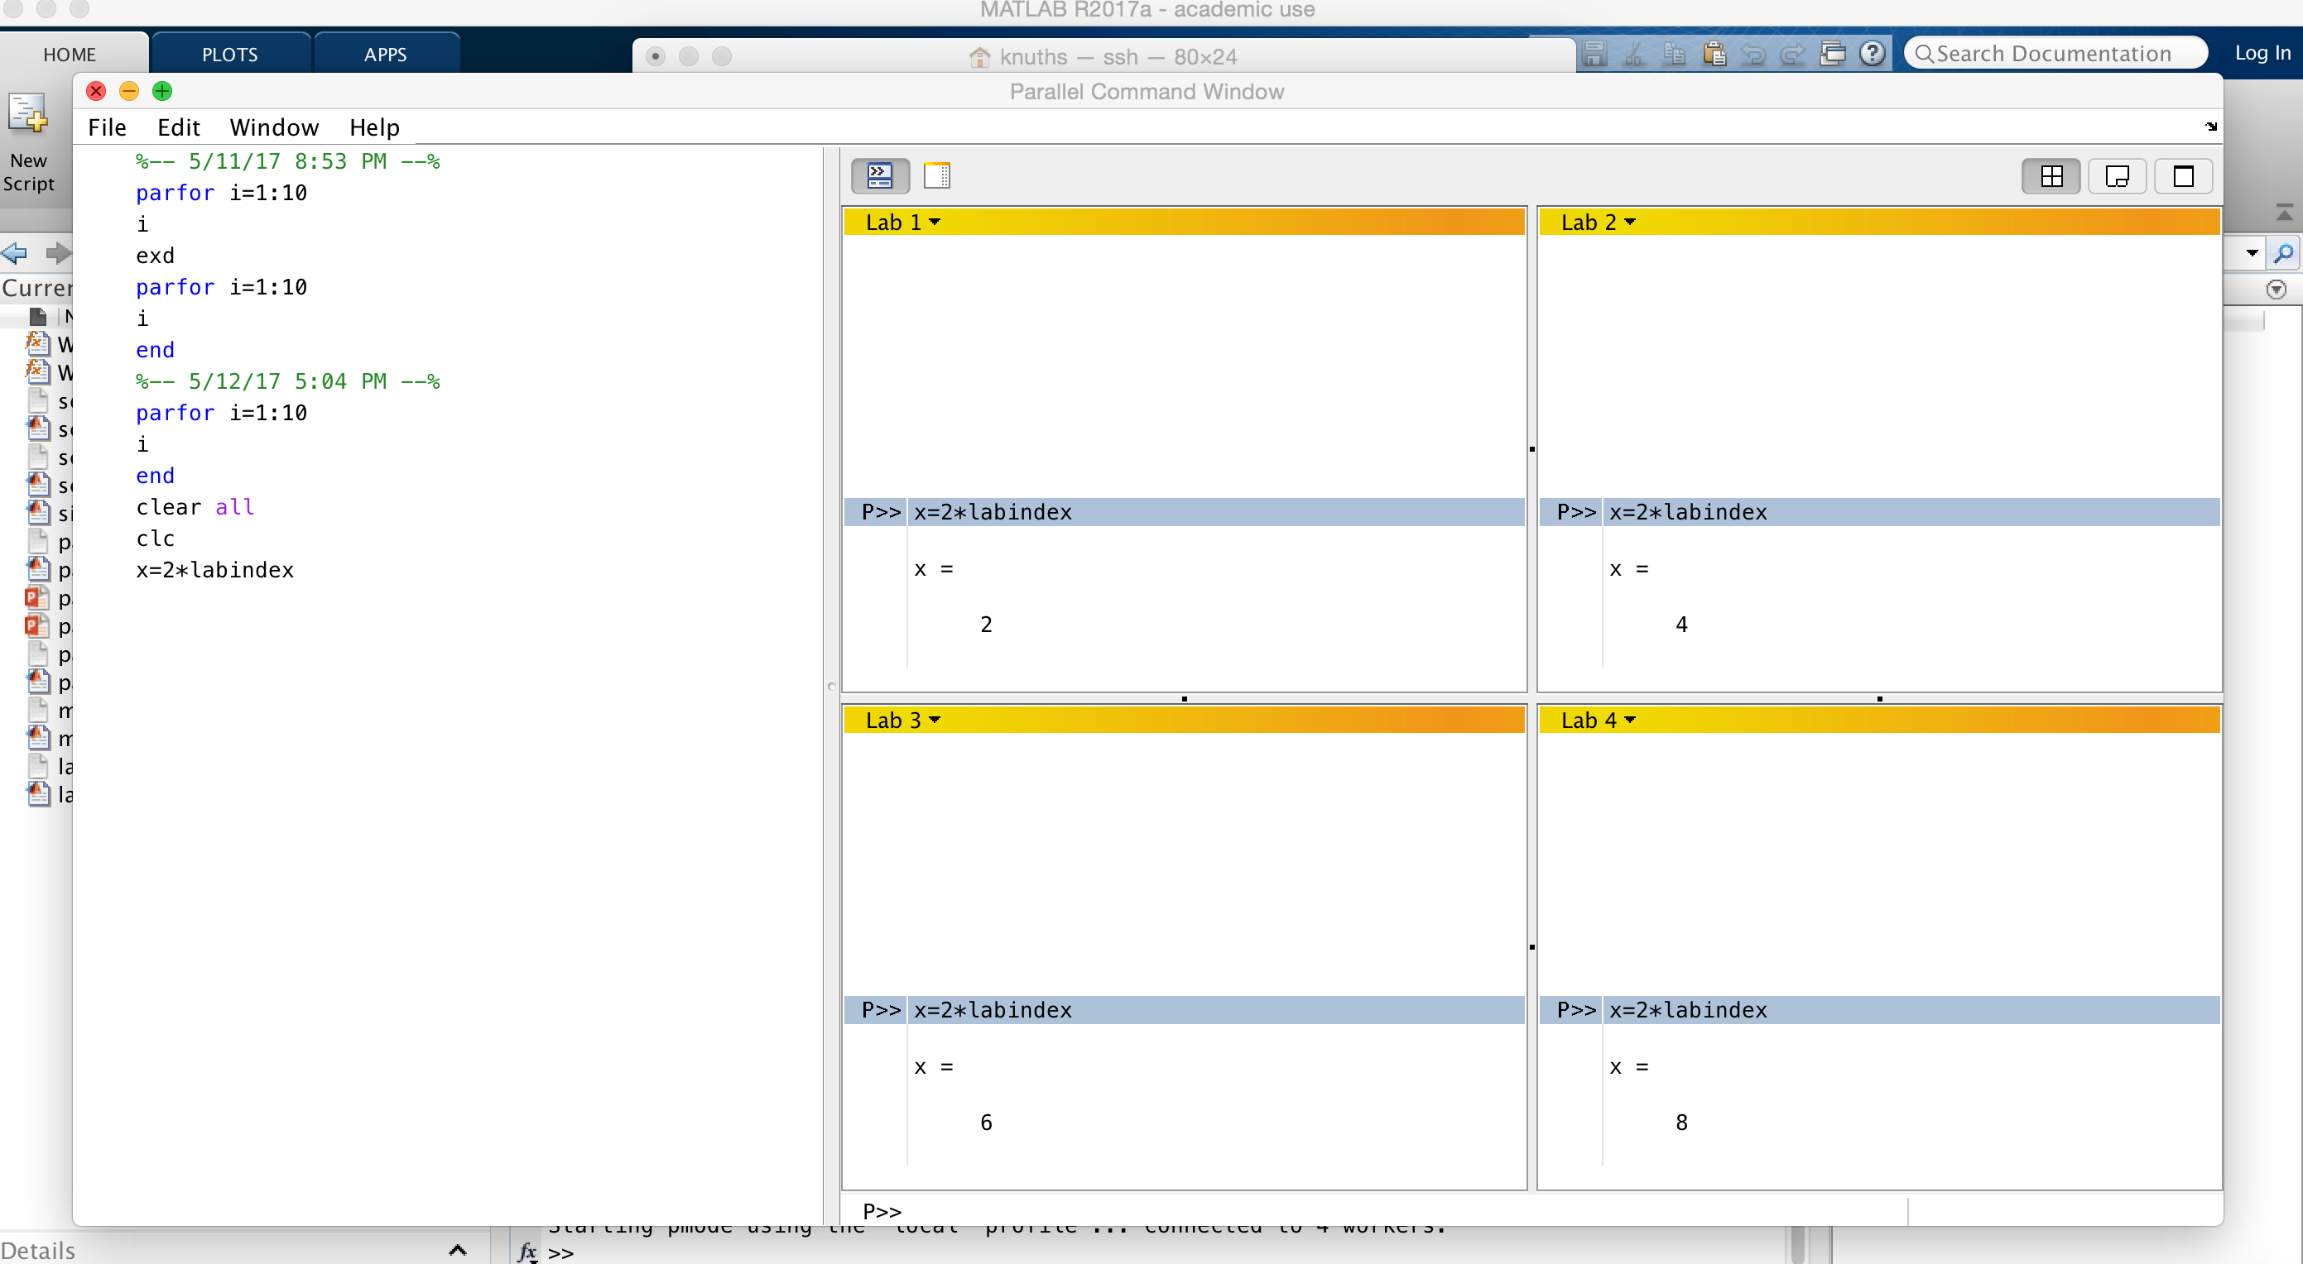

Slide 37
Questions?
Email rc-help@colorado.edu
Twitter: CUBoulderRC
Link to survey on this topic: http://tinyurl.com/curc-survey16
Slides: https://github.com/ResearchComputing/Parallelization_Workshop

